Slide 1





Introduction to SQL Server and MySQL
Svetlin Nakov
Manager Technical Training
http://nakov.com
Telerik Software Academy
http://academy.telerik.com

Slide 2


Table of Contents
SQL Server 2012 – Intro
SQL Server Services
Types of Databases
Authentication and Permissions
SQL Server Management Studio
Moving a SQL Server Database
Through Backups and Restore
By Detaching and Attaching

Slide 3
Table of Contents (2)
MySQL – Intro
MySQL Community Server
MySQL Services, Start, Stop
Authentication and Login
MySQL Console Client
MySQL Workbench
phpMyAdmin Tool
Moving a MySQL Database

Slide 4

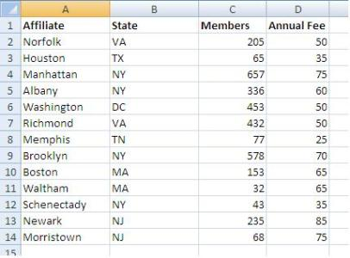

MS SQL Server 2012
Overview

Slide 5
What is Microsoft SQL Server?
MS SQL Server is a Relational Database Management System (RDBMS) from Microsoft
The main language supported in SQL Server is Transact SQL (T-SQL), an extension of SQL
Powerful, trustworthy, easy-to-use DB server
The most recent version is SQL Server 2012
Works only on Windows systems
A free distribution exists (SQL Server Express)
http://www.microsoft.com/express/database/

Slide 6
Services of SQL Server 2012
SQL Server – the database engine
Responsible for database management, data storage, queries, data manipulation, data integrity, transactions, locking, users, security
Executes SQL / T-SQL queries
SQL Server Agent – DB monitoring
Executes scheduled tasks
Monitors SQL Server
Sends notifications about problems

Slide 7
Services in SQL Server 2012 (2)
Distributed Transaction Coordinator (MSDTC)
Manages database transactions
Supports transactions that span multiple databases
Coordinates committing the distributed transaction across all the servers that are enlisted in the transaction
Implements 2-phase commit

Slide 8





SQL Server Databases
Northwind
msdb
tempdb
msdb

Slide 9
SQL Server Databases
SQL Server has system and user databases
System databases
Maintain internal information about MS SQL Server as a system
Don't play with them!
User databases
Databases created by users (developers)
Store user's schemas and data
Use the system databases internally

Slide 10


Types of SQL Server Databases
System Databases
master
model
tempdb
msdb
distribution
pubs
Northwind
…
User Databases

Slide 11
System Databases
Master – meta-database keeping data about
User accounts
Configurable environment variables
System error messages
Model – a prototype for new databases
Tempdb – storage for temporary tables and database objects
MSdb – alerts and scheduled tasks

Slide 12
SQL Server Databases
Each SQL Server database consists of two files:
.mdf file
Contains the core data in the database
Schema, tables data, and other database objects
.ldf file
Transaction log – keeps track of transactions
You need both these files to use the database

Slide 13


SQL Server Authentication

Slide 14
Connecting to SQL Server
Connecting to SQL Server requires
The name of the server (e.g. localhost)
The name of the DB instance (e.g. SQLEXPRESS)
The name of the database (e.g. Northwind)
Username / password (if using SQL Server authentication)
Types of authentication in SQL Server
Windows (by using a Windows user credentials)
Mixed (both Windows and SQL Server)

Slide 15
SQL Server Users Permissions
Each user has certain permissions and roles for a database (Database User Account)
A role defines a group of users with the same permissions
There are 3 types of roles in MS SQL Server
Fixed server roles
Fixed database roles
User-defined database roles

Slide 16
Fixed Database Roles
Public – maintains all default permissions for users in a database
Db_owner – performs any database role activity
Db_accessadmin – add or remove database users, groups, and roles
Db_ddladmin – add, modify, or drop database objects
Db_securityadmin – assign statement and object permissions
Others…

Slide 17
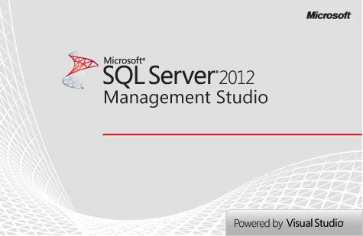


SQL Server Management Studio
A Powerful Management Tool for Administrators and Developers

Slide 18
SQL Server Management Studio (SSMS)
SQL Server Management Studio (SSMS) is a powerful graphical DB management tool
Administrate databases (create, modify, backup / restore DB)
Create and modify E/R diagrams
View / modify table data and other DB objects
Execute SQL queries
Free and easy to use tool
Works with all SQL Server versions

Slide 19
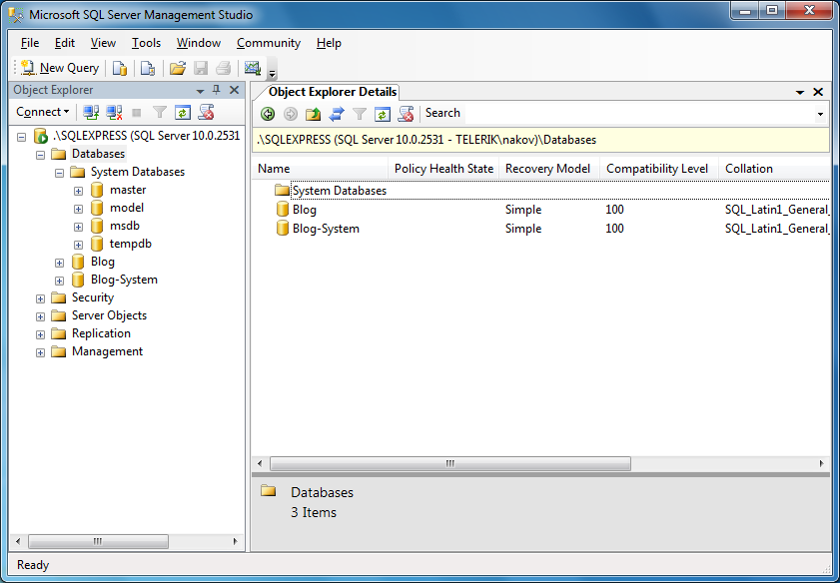
SQL Server Management Studio – Screenshot

Slide 20
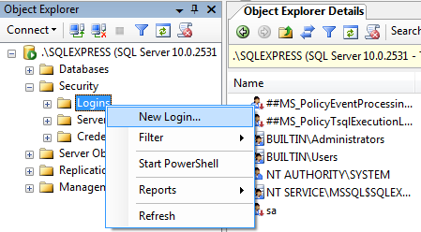
SSMS Setting Server Account
You can use SSMS to create database user / give permissions to Windows users
Follow these steps:
Right click on the [Security / Login] folder in Object Explorer and choose "New Login…"

Slide 21
SSMS Setting Server Account (2)
In the next dialog click the [Search] button
Select one of the Windows accounts in a typical Windows fashion
Leave the authentication method set to Windows authentication
Click [OK]
Thus you create an SQL Server User account
Account permissions could be assigned later
Windows administrators already have access

Slide 22
SSMS Setting Database Account
Right click on the "Security" under some of the databases and choose "New" → "User"
Enter username and select one of the Server accounts to use
Assign the roles for this user
Click [OK] to confirm
By selecting the [Name-of-Database] → "Properties" → "Permissions" you can also set specific permissions for the accounts

Slide 23
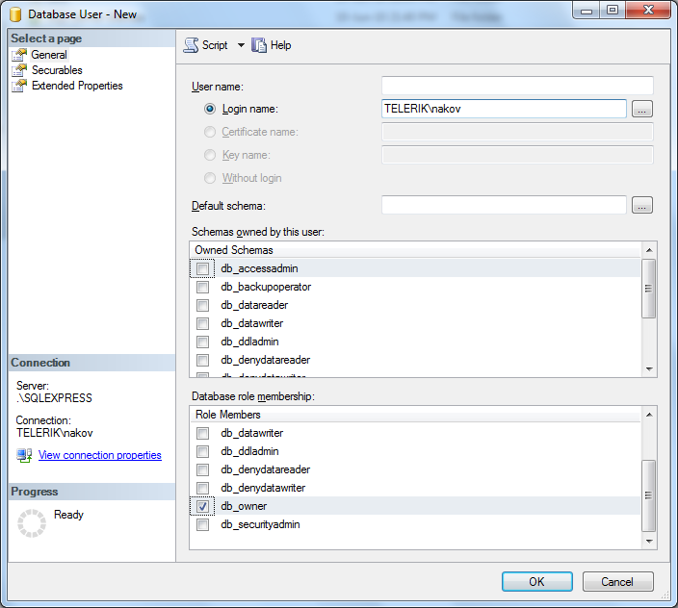
Creating Database Users – Screenshot

Slide 24

Creating Accounts and Assigning Permissions in SQL Server
Live Demo

Slide 25
Using SQL Server Management Studio
SSMS can be used to visually edit the structure or data in a database
It can execute T-SQL queries
Select the database you want to work with in the Object Explorer
Click the [New Query] button
Write the query in the window to the right of Object Explorer
Click the [Execute] button

Slide 26
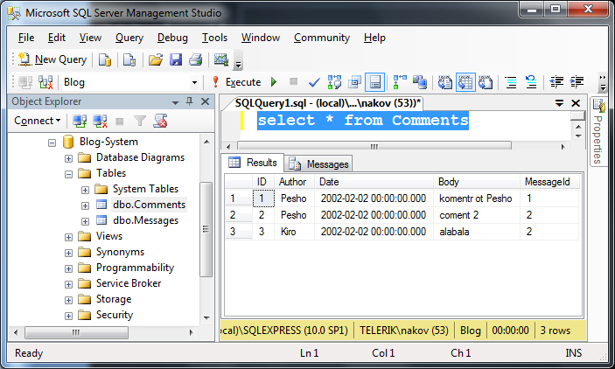
Executing SQL – Screenshot

Slide 27
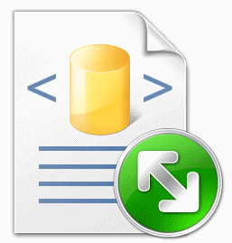

Executing Simple SQL Queries in SQL Server Management Studio
Live Demo

Slide 28

Moving an SQL Server Database

Slide 29
Moving a SQL Server Database
Necessary when we install a certain application at the customer environment
Ways of moving an SQL Server database:
By backup and restore
Create backup and restore it on the other server
By detaching and attaching the database files
The 2 servers must be the same versions!
By dumping the database as SQL script
Not supported in SSMS

Slide 30
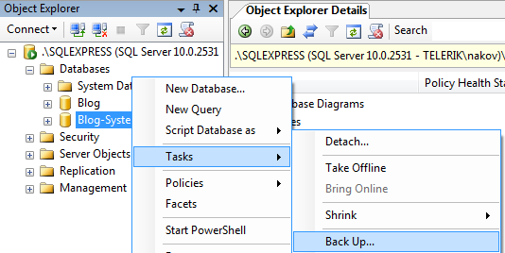
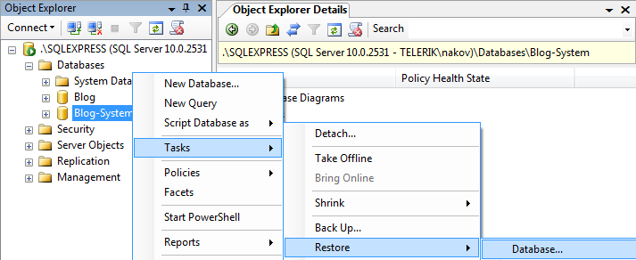
Moving by Backup and Restore
Backup and restore database through SSMS

Slide 31
Moving DB by Detaching and Attaching
On the source server:
Choose the database in SQL Server Management Studio
From the context menu we choose the Detach command
We copy the database files from the source server to the destination server:
<database_name>.mdf
<database_name>.ldf

Slide 32

Moving a Database by Detaching and Attaching
Live Demo

Slide 33
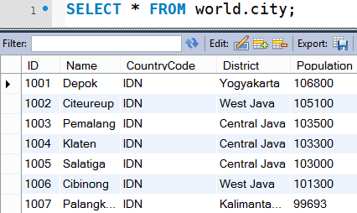
MySQL Server
Overview

Slide 34
What is MySQL?
MySQL Database Server
MySQL is open-source DB server (RDBMS)
World's most-popular open-source database
Mostly used to power web sites and small apps
Supports concurrency, transactions (full ACID)
Stored procedures, views, triggers, partitioning
Support clustering and replication
Free and paid editions
Community Server, Enterprise, Cluster CGE

Slide 35
MySQL Community Server
MySQL Community Server
The free open-source MySQL edition
Windows:
Pre-packaged installer available from http://dev.mysql.com/downloads/mysql/
Linux:
Available through the package managers
E.g. apt-get install mysql-server, yum install mysql-server

Slide 36
MySQL Storage Engines
MyISAM
Fast, non-transactional → unreliable, forget it!
InnoDB
Fully ACID transactional, highly reliable
Recommended for most applications
Memory
Ultra-fast, non-persistent
CSV
Stores the data in CSV (text) files

Slide 37
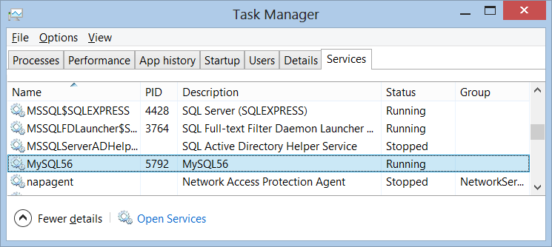
MySQL Services, Start, Stop
MySQL Services
Just one service (in Windows): MySQL56
Starting: net start MySQL56
Stopping: net stop MySQL56

Slide 38
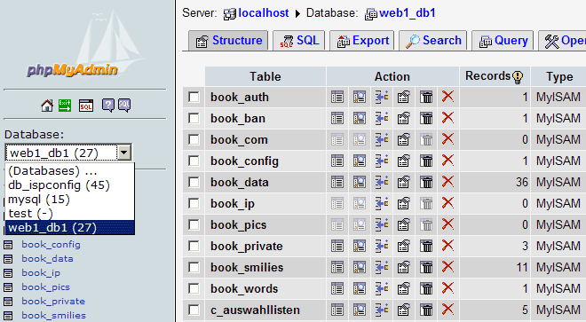
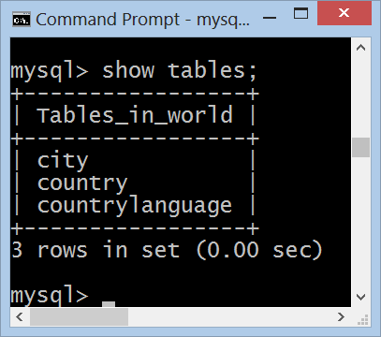
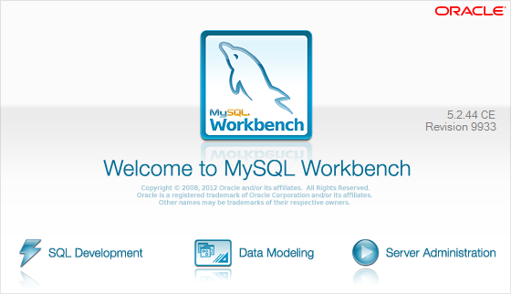

MySQL Administration Tools
The Console Client, MySQL Workbench, phpMyAdmin

Slide 39
Authentication and Login
MySQL uses traditional username / password authentication
The administrator's user is: root
The default password is specified during the installation process
Connecting through the console client
mysql –u root -p
use world;
select * from city limit 100;

Slide 40
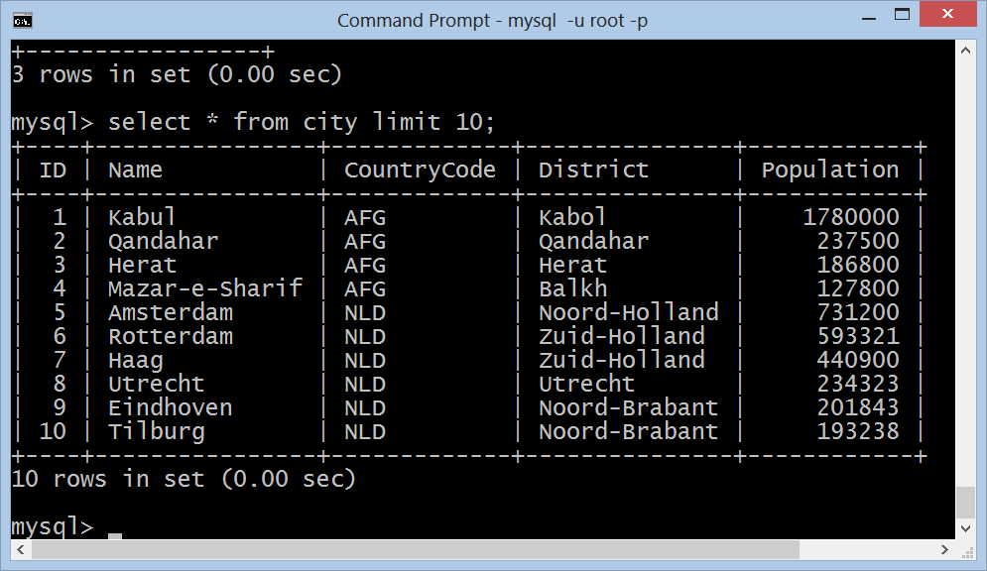
MySQL Console Client
Live Demo

Slide 41
MySQL Workbench
MySQL Workbench is free open-source GUI administration tool for MySQL
Execute SQL queries
Browse / edit table data
Create / modify relational schema
DB design (E/R diagrams)
Forward / reverse engineering
Visualize query plan

Slide 42
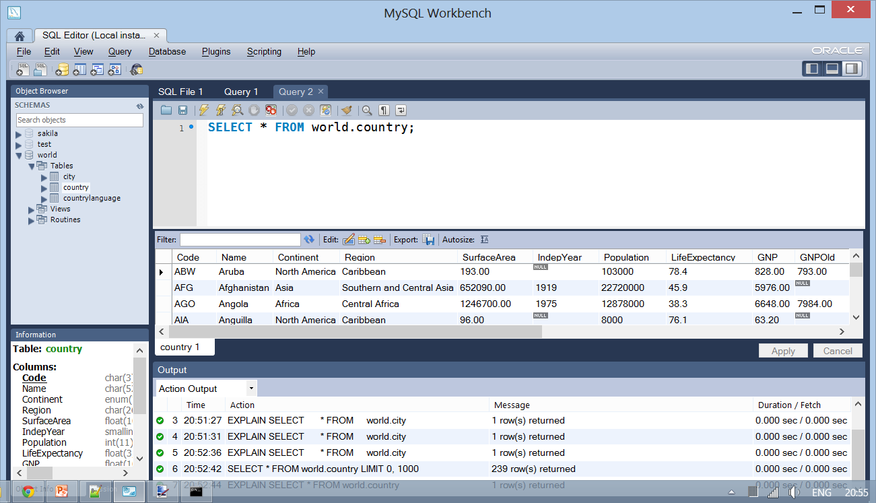
MySQL Workbench
Live Demo

Slide 43
phpMyAdmin Tool
phpMyAdmin Tool
Web-based open-source MySQL admin tool

Slide 44
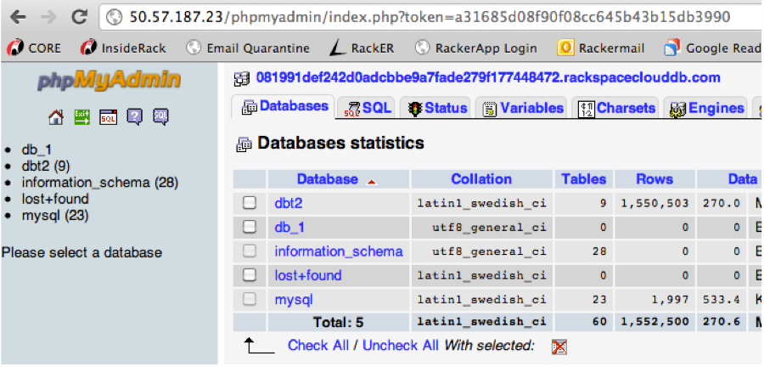
phpMyAdmin
Live Demo

Slide 45
Moving a MySQL Database
To move MySQL database to another location
Use SQL export / SQL import feature
Export a database to SQL script
MySQL Workbench → Server Administration → Data Export → Export to Self-Contained File
phpMyAdmin → Export → SQL
Import a database from SQL script
Just execute the script in Workbench
phpMyAdmin → Import → SQL

Slide 46
Introduction to SQL Server and MySQL
http://academy.telerik.com

Slide 47
Exercises
Download and install SQL Server Express. Install also SQL Server Management Studio Express (this could take some effort but be persistent).
Connect to the SQL Server with SQL Server Management Studio. Use Windows authentication.
Create a new database Pubs and create new login with permissions to connect to it. Execute the script install_pubs.sql to populate the DB contents (you may need slightly to edit the script before).
Attach the database Northwind (use the files Northwind.mdf and Northwind.ldf) to SQL Server and connect to it.

Slide 48
Exercises (2)
Backup the database Northwind into a file named northwind-backup.bak and restore it as database named North.
Export the entire Northwind database as SQL script. Use [Tasks] -> [Generate Scripts]. Ensure you have exported table data rows (not only the schema).
Create a database NW and execute the script in it to create the database and populate table data.
Detatch the database NW and attach it on another computer in the training lab. In case of name collision, preliminary rename the database.

Slide 49
Exercises (3)
Download and install MySQL Community Server + MySQL Workbench + the sample databases.
Export the MySQL sample database "world" as SQL script.
Modify the script and execute it to restore the database world as "worldNew".
Connect through the MySQL console client and list the first 20 tons from the database "worldNew".

Slide 50




Free Trainings @ Telerik Academy
C# Programming @ Telerik Academy
csharpfundamentals.telerik.com
Telerik Software Academy
academy.telerik.com
Telerik Academy @ Facebook
facebook.com/TelerikAcademy
Telerik Software Academy Forums
forums.academy.telerik.com

